Slide 1
SWEN 4342 Project

Slide 2

Pipe-Filter Architecture Style
The high-level design solution is decomposed into two “generic” parts (filters and pipes):
Filter is a service that transforms a stream of input data into a stream of output data.
Pipe is a mechanism or conduit through which the data flows from one filter to another.
Input
time cards
Prepare for
check processing
Process checks
** Reminds one of DFD without the data store or source sink.**
Problems that require batch file processing seem to fit this architecture: e.g., payroll, compilers, month-end accounting.

Slide 3
Event Driven (Real Time)
The high-level design solution is based on an event dispatcher, which manages events and the functionalities that depend on those events. These have the following characteristics:
Events may be a simple notification or may include associated data.
Events may be prioritized or be based on constraints such as time.
Events may require synchronous or asynchronous processing.
Events may be “registered” or “unregistered” by components.
voice
call
Phone
processing
text
msg
Personal (device)
dispatcher
Text
processing
Image
keypad
Image
processing
Problems that fit this architecture include real-time systems such as: airplane control,
medical equipment monitor, home monitor, embedded device controller, game, etc.
- - - Try a commercial flight control system - - -

Slide 4
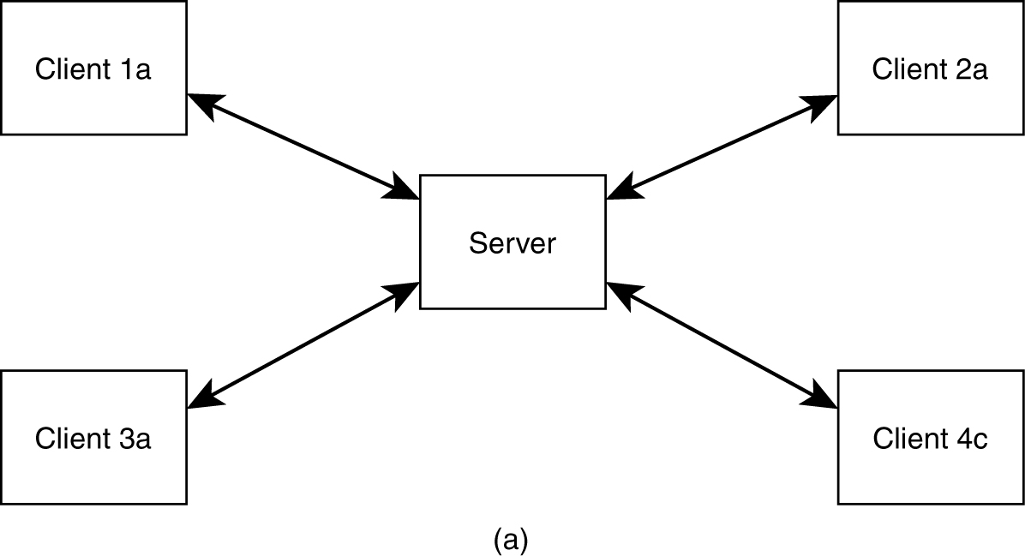
Basic Client-Server Style
Application split into client component and server component.

Slide 5
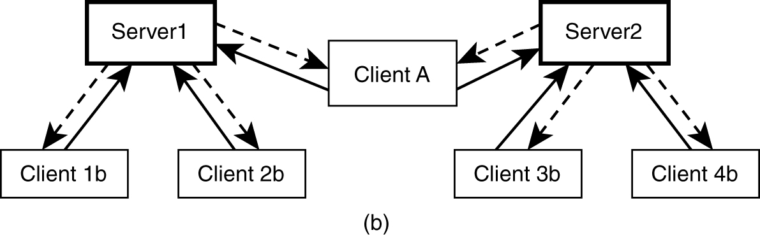
Client-Server Style
Client may connect to more than one server (servers are usually independent).

Slide 6
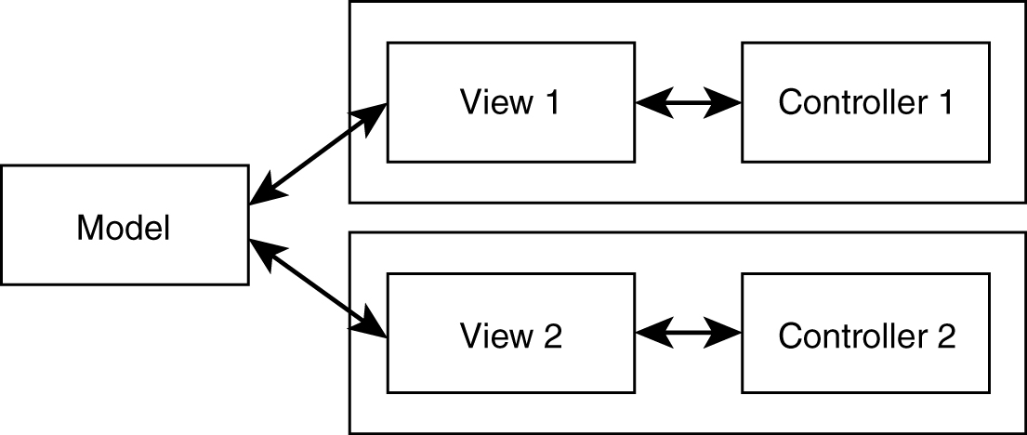
Model-View-Control (MVC) Style
Separates model (data) from view.
Controller often integrated with view nowadays.
Most internet web applications fall under this style.

Slide 7
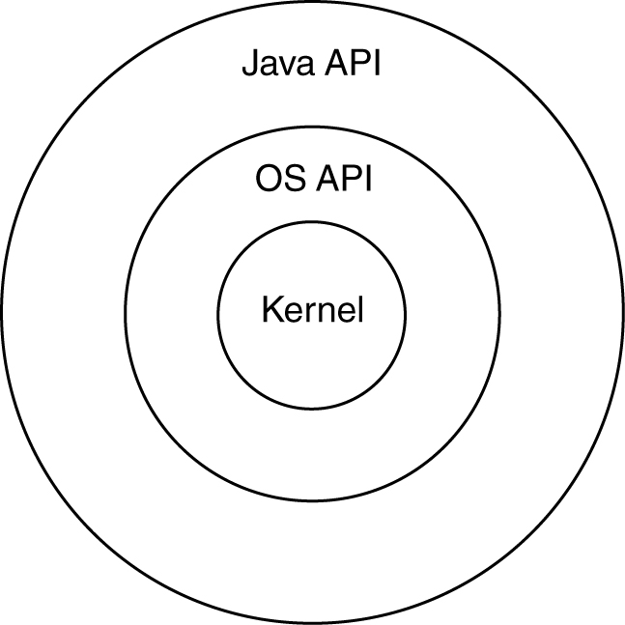
Layered Style
The “outer” layer can only ask for service from the “inner” layer; the “upper” layer can only ask for service from the “lower” layer.
− Strict layering: only directly inside or below layers
− Relaxed layering: any inside or below layers

Slide 8
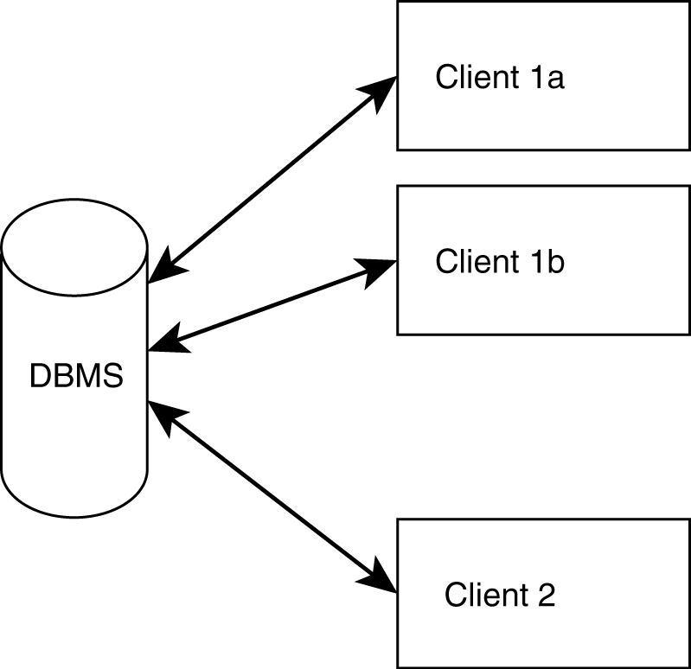
Shared Data (DB)-Centric Style
Very popular within the business applications community

Slide 9
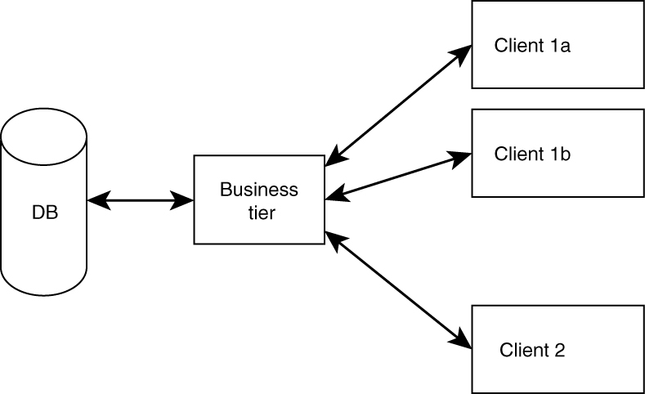
Three-Tier Style (Mixture)
Clients do not access DB directly.
Better flexibility, integrity. (Why?)
Reminds one of client server or MVC.

Slide 10
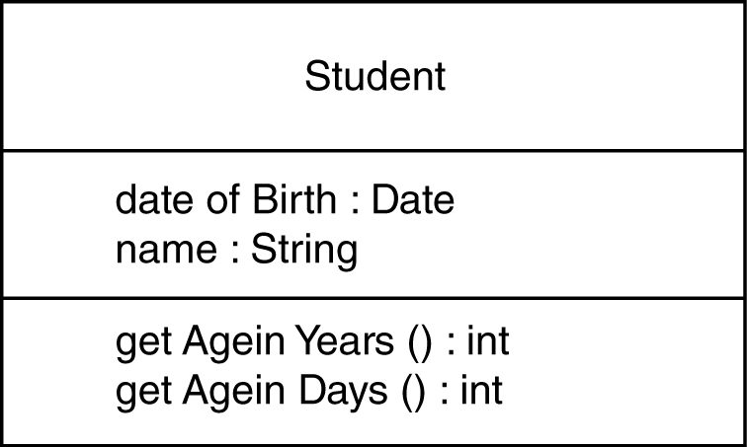
Class Design
Classes represent real-world entities or system concepts.
Organized into classes: objects in a class have similar characteristics.
Classes have properties (attributes or data).
Classes also have methods (perform functions).

Slide 11
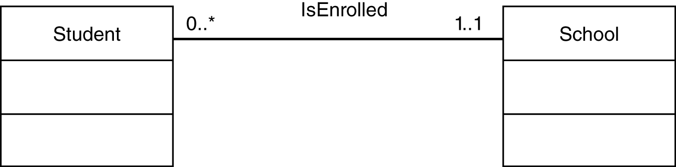
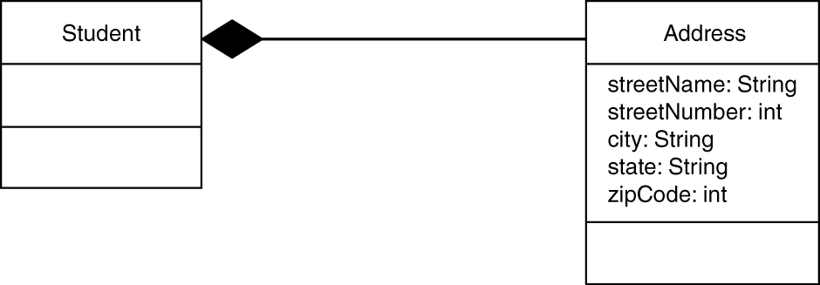
UML Class Diagrams
Association
Composition
Use “no-fill” diamond for aggregation.

